Slide 1
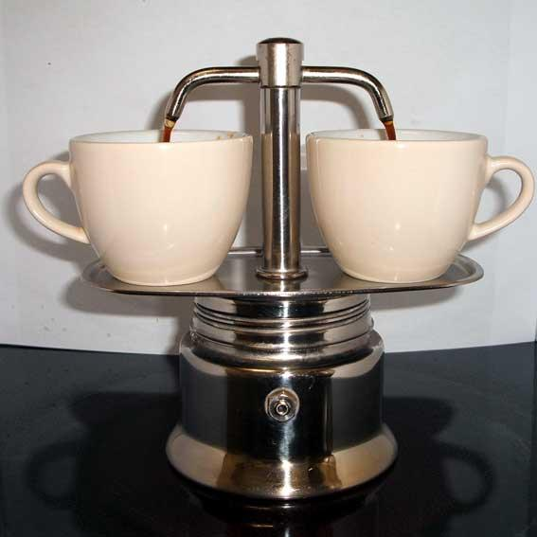
Amste Coffee For late workers
By: Prisha and Maria

Slide 2
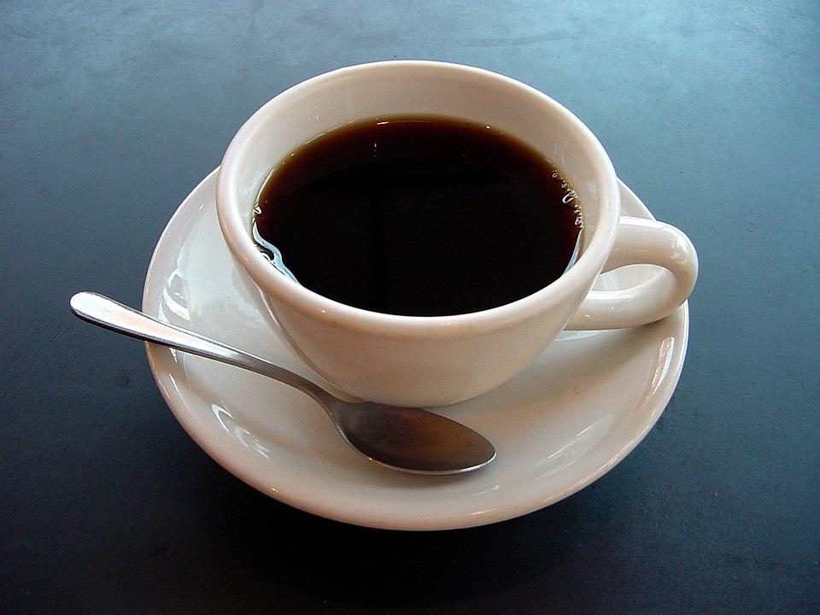
Tired after coming home? Drink Amste’s purr–fect coffee!

Slide 3
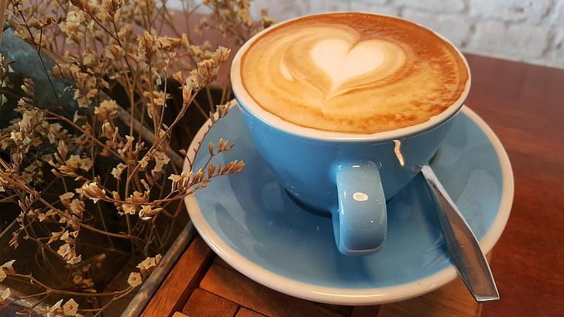
Very easy to use
Makes warm and soothing coffee
Doesn't need charging stop
Works for 24 hrs non-stop

Slide 4
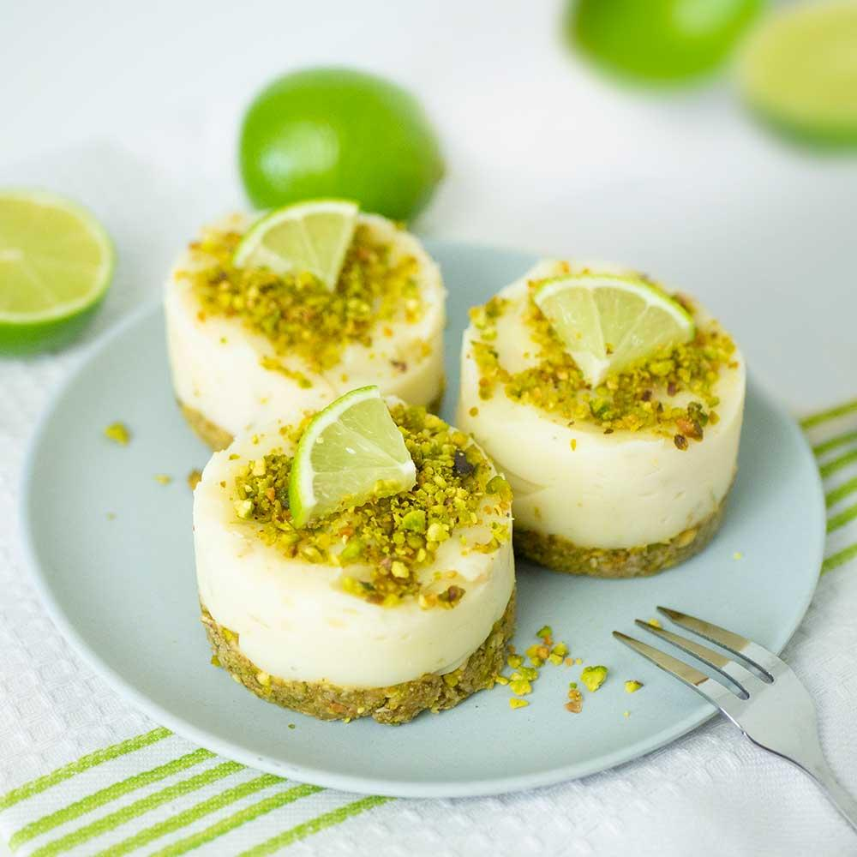
Made best with pistachio cake — and a twirl of sugar

Slide 5
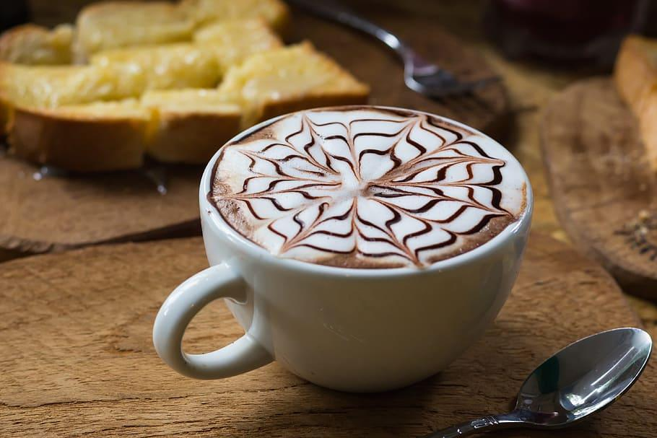
Prices
US $25.00
or Best Offer
Was US $50.00 (50% off

Slide 6
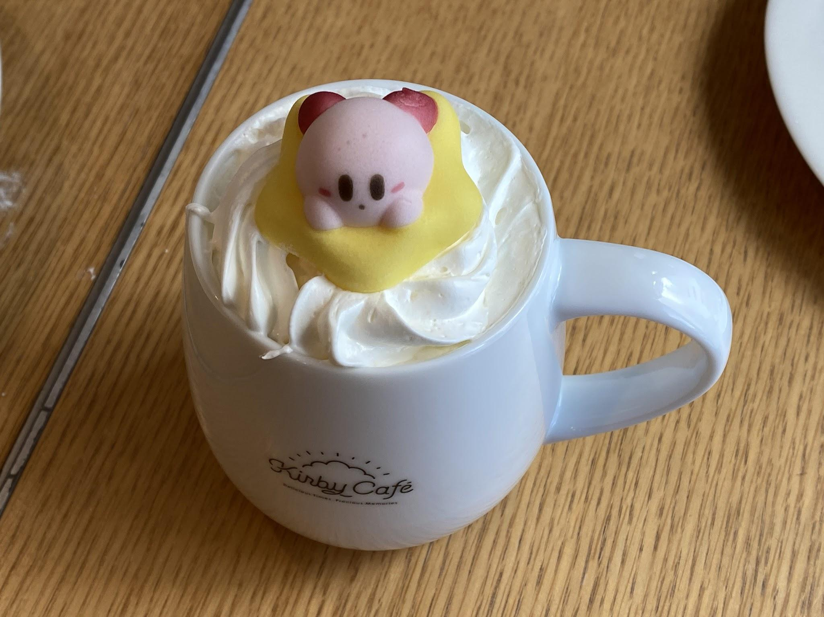
The end
— Prisha and Maria
A gift from us— https://www.youtube.com/watch?v=jh4C7w-dvho

